Slide 1
Canvas in JavaScript

Slide 2
Canvas Element
The <canvas> element in HTML5 can be used to draw shapes on Web sites as well as to dynamically draw graphics using JavaScript.
The <canvas> element is represented like a rectangle on a page and allows the user to draw arcs, text, shapes, gradients, and patterns.
The <canvas> in HTML5 is like the <div>, <table>, or <a> tag except that the content used in it is rendered through JavaScript.
The <canvas> element does not contain any drawing abilities, instead, the drawing is done using a JavaScript code.
To make use of the <canvas> element, a user has to add the <canvas> tag on the HTML page.
Using <canvas> with JavaScript improves the overall performance of Web sites and avoids the requirement to download images from the sites.

Slide 3
Canvas Element
The Code Snippet demonstrates the use of <canvas> element.
^{<!DOCTYPE HTML>}
^{<html>}
^{<head>}
^{<title> Canvas </title>}
^{<style>}
canvas{border: medium double red; margin: 4px}
^{</style>}
^{</head>}
^{<body>}
<canvas width=”278” height=”200”></canvas>
^{</body>}
^{</html>}
In the code, the <style> element is used to display the border of the <canvas> element.
The height and width attributes specify the size of the <canvas> element on the page.

Slide 4
Canvas Element
Following figure displays the <canvas> element.
To draw a <canvas> element, the user can use a context object.
The context object contains the drawing functions for a specific style of graphics.
Two-Dimensional (2d) context is used to work with 2d operations.

Slide 5
Canvas Element
The <canvas> element in DOM exposes the HTMLCanvasElement interface.
This interface provides the methods and properties for changing the presentation and layout of canvas elements.
The HTMLCanvasElement has a getContext(context) method that returns the drawing context for the canvas.
In the code, the height and width attributes define the height and width of the canvas element respectively.
In the initializer function, the DOM object is accessed through the id attribute and gets a 2d context by using the getContext() method.
The rectangle is created by using the rect(18, 50, 200, 100) method with x, y, height, and width parameters and is positioned at left corner of the page.

Slide 6
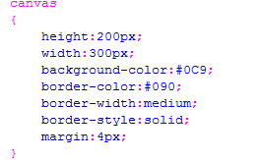

Canvas Element
The Code Snippet demonstrates the 2d context object for the canvas.

Slide 7
Drawing a Line in Canvas
You can create lines in a canvas using the stroke(), beginPath(), lineTo(), and moveTo() methods.
The following is the syntax to create a line in canvas:
^{Syntax:}
^{ctext.beginPath();}
^{ctext.moveTo(x,y);}
^{ctext.lineTo(x,y);}
^{ctext.stroke();}
^{where,}
ctext - specifies a context object
beginPath() - Specifies a new drawing path
moveTo() - Specifies the creation of new sub path to the given position
lineTo() - Specifies the drawing of a line from the context position to the given position
stroke() - Specifies how to assign a color to the line and display it

Slide 8
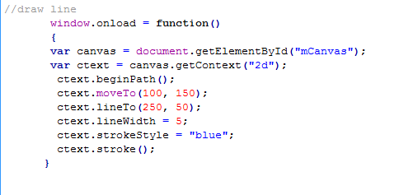
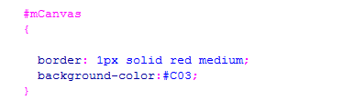

Drawing a Line in Canvas
The Code Snippet demonstrates creating a line in HTML5 canvas.

Slide 9
Drawing a Line in Canvas
In the code, the height and width attributes are defined.
The initializer function has the DOM object which is accessed through the id attribute and gets a 2d context by using the getContext() method.
The beginPath() method is called through the context object to draw the path of the line.
The moveTo(100, 150) method is called that creates a new path for the given point to place the drawing cursor and moves the position of the window to the upper-left corner by giving the x and y coordinates.
The lineTo(250, 50) method is called to draw the line from the context point to given point.
The lineWidth property is specified as 5 to define the width of the line on the canvas.
The strokeStyle property sets the color of the line to blue.
The stroke() method assigns the color to the line.

Slide 10
Working with Drawing Objects
HTML5 canvas allows the user to work with different types of drawing objects.
Following objects can be drawn on a canvas element:
Rectangle
With HTML5 canvas, the user can create a rectangle using the rect() method.
The HTML5 canvas is placed by using the x and y parameters and appropriately sized through height and width properties.
Following table lists the common properties and methods of various shapes.
^{Properties and Methods} | ^{Description}
^{fillStyle} | The values can be gradient, pattern, or a CSS color. The default property style is solid black, but the user can set the color according to the requirements.
^{filRect(x, y, width, height)} | Enables the user to draw a rectangle with the existing fill style.
^{strokeStyle()} | The values can be gradient, pattern, or a CSS color.

Slide 11
Working with Drawing Objects
^{Properties and Methods} | ^{Description}
strokeRect(x, y, width, height) | Enables the user to draw a rectangle with the existing stroke style. This property is used to draw the edges of the rectangle.
^{clearRect(x, y, width, height)} | Used to clear the pixels in a rectangle.
^{The} Code Snippet demonstrates how to create a rectangle in HTML5 canvas.

Slide 12
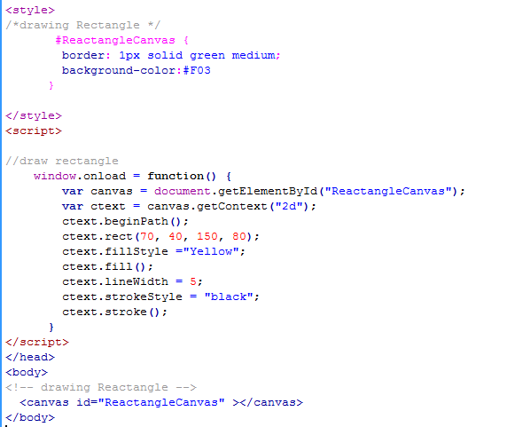
Working with Drawing Objects

Slide 13
Working with Drawing Objects
In the code, the height and width attributes are defined.
The initializer function has the DOM object which is accessed through the id attribute and gets a 2d context by using the getContext() method.
The beginPath() method is called through the context object to draw the rectangle.
The rect(30, 50, 150, 100) method takes x, y, height, and width as the parameters.
The fillStyle property fills the rectangle with magenta color.
The fill() method is used to paint the rectangle.
The lineWidth property is specified as 5 to define the width of line on the canvas.
The strokeStyle property sets the stroke style of the rectangle to black.
The stroke() method assigns the color to the rectangle.

Slide 14
Working with Drawing Objects
Circle
In HTML5, you can draw a circle using the arc() method.
You have to set the start angle with 0 and the end angle is specified as 2 * PI.
Following is the syntax to draw a circle in HTML5 is as follows:
^{Syntax:}
arc(x, y, radius, startAngle, endAngle, anticlockwise)
^{where,}
x, y - Specifies the coordinates of the center of an arc
radius - Specifies the distance from the center to any point on the circle
startAngle, endAngle - Specifies the start and end points in the arc
anticlockwise - Draws the arc clockwise or anticlockwise and accepts a boolean value

Slide 15
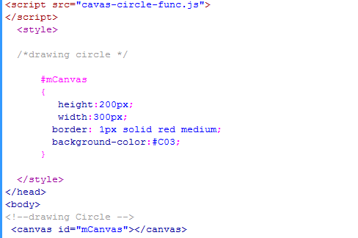
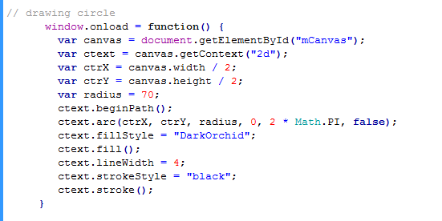
Working with Drawing Objects
The Code Snippet demonstrates how to create a circle using HTML5.

